Slide 1

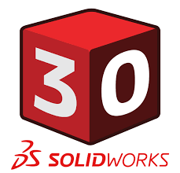
Hawk Ridge Systems #SW30
Campaign Recap Deck

Slide 2
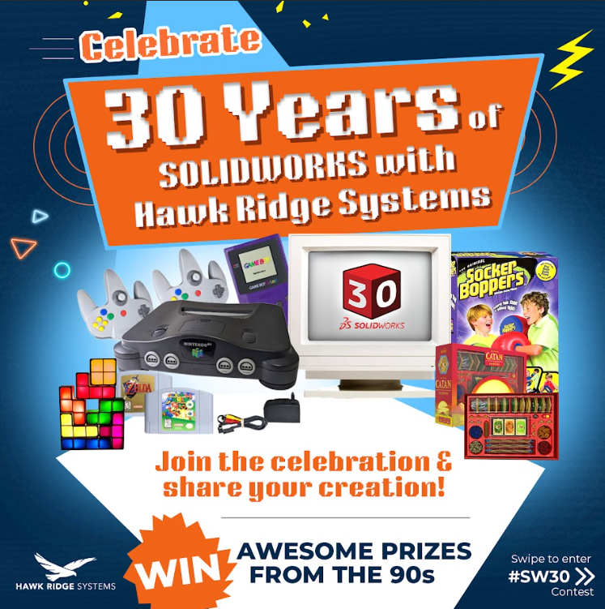
INTRODUCTION TO CAMPAIGN
This campaign celebrates the 30-year legacy of SOLIDWORKS by spotlighting the emotional and technical milestones of engineers, designers, and makers across North America.
For three decades, SOLIDWORKS has been the creative playground for innovators — from their very first part to the breakthroughs they design today. Hawk Ridge Systems is celebrating these stories by connecting the community through a new campaign, with a creative direction inspired by the ’90s. Designed to spark nostalgia, pride, and shared experiences, the campaign brings the SOLIDWORKS journey full circle.

Slide 3
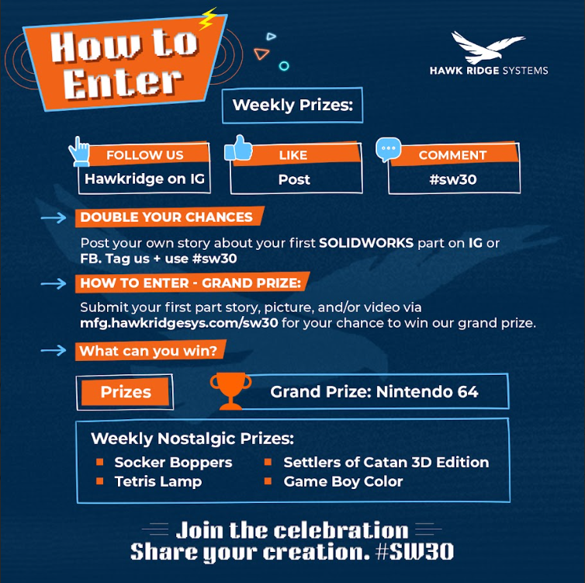
Campaign Objective
Goals:
Promote the SolidWorks 30th Anniversary contest and drive engagement & leads through Meta campaigns and supporting content.
Warm up the audience for our 30% off solidworks promo in Q4
KPIs:
Awareness & engagement on SolidWorks 30th posts
Landing page visits and form submissions

Slide 4
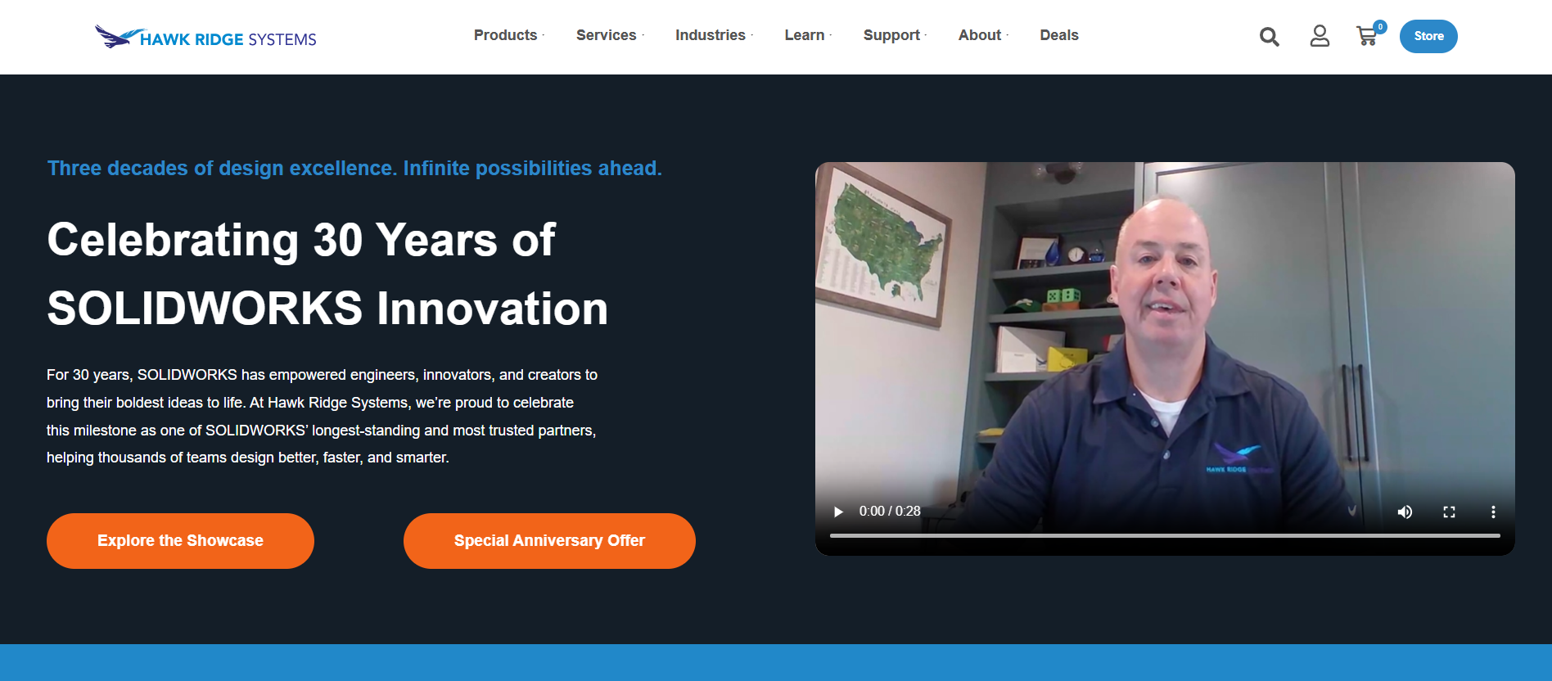
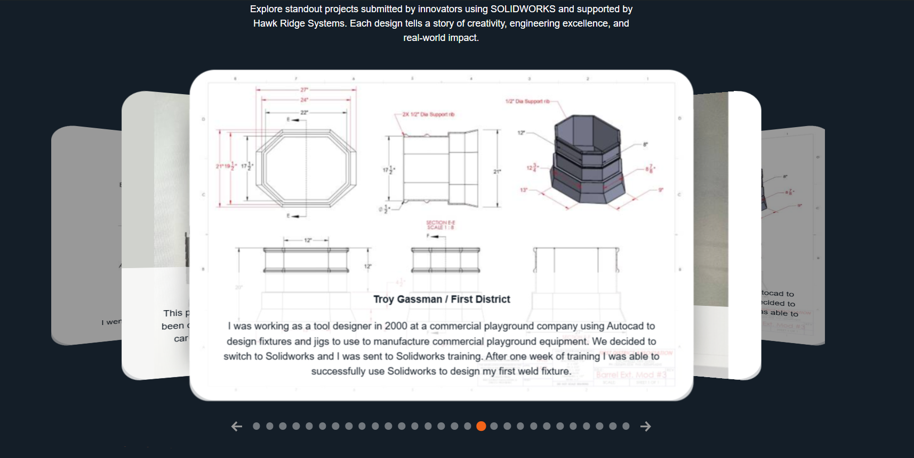
The plan!
Component | Description
Landing Pages (submission page & showcase page) | Contest page with form for SolidWorks 30th celebration submissions.
Meta Ads | Carousel and engagement ads driving contest awareness
Organic Social | “30 years of SolidWorks” countdown posts to build excitement
Automation | Email confirmation and reminder sequences for participants
Internal Email Sends | Tapping our current customer base for engagement

Slide 5
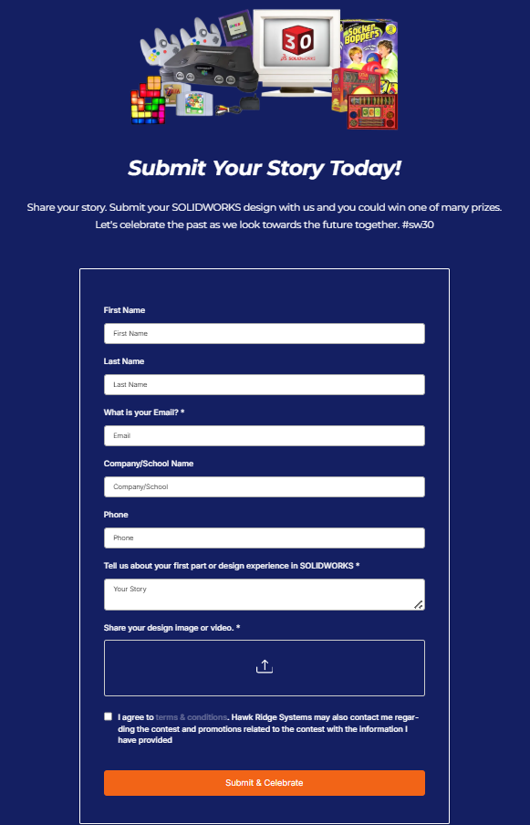
Landing Page
& Contest Flow
Designed around celebration theme and community engagement
Clear CTA: “Enter to Win” with short form fields
Optimized for mobile and desktop
Visual continuity with Meta and organic assets

Slide 6
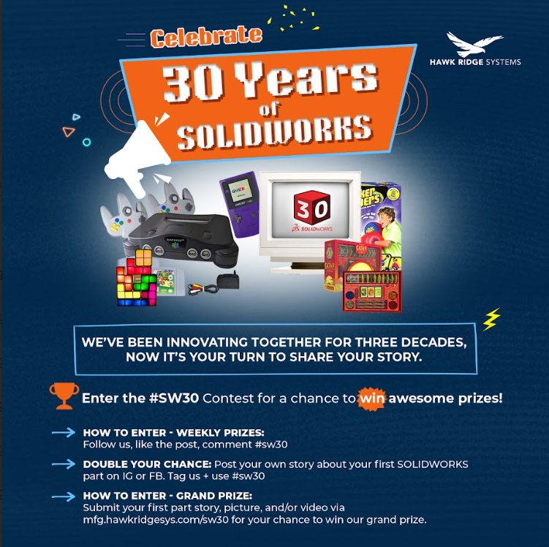
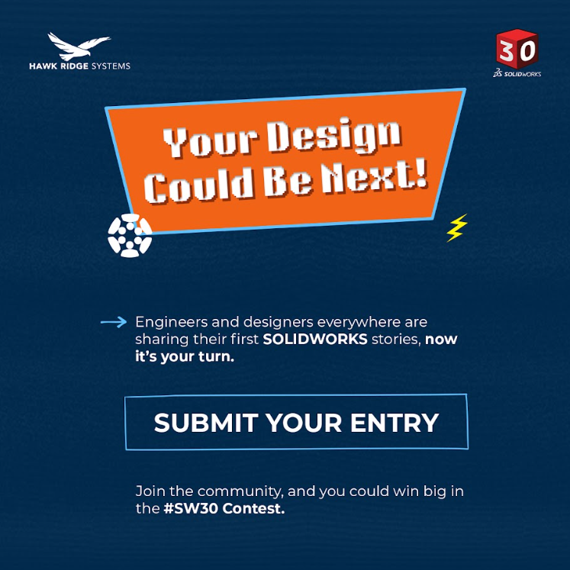
Meta Ads & Creative Examples
Featured carousel and engagement ad variations
Messaging focused on nostalgia (“30 years of innovation”) and incentives (“Win amazing prizes”)
Video + image mix tested for engagement and clicks
📈 Top Ad Metrics:
1,018 link clicks • $0.31 CPC • 61K impressions
73K+ impressions on first story post (“your first SOLIDWORKS story Could Score you some…”)

Slide 7
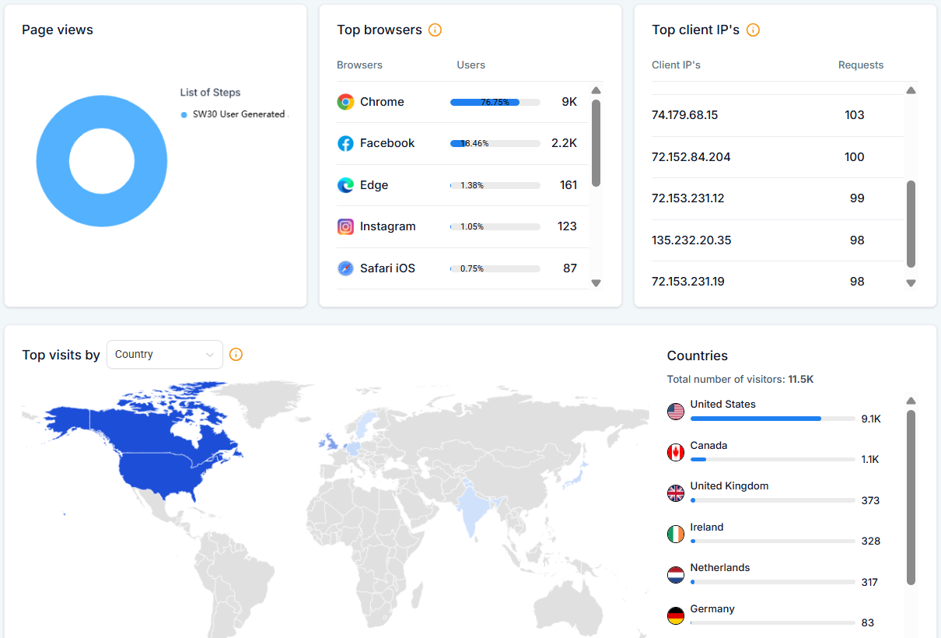
Ads Performance Snapshot
Metric | Result
Total Impressions (Contest Ads + Posts) | 310,972
Total Post & Ad Engagements (clicks / likes / etc) | 2,746
Landing Page Submissions (30 Days) | 46
Total Post & Ad Reach | 138,473
Ad Spend | $1,948.12
Top Post Performance | “The Prizes” – 876 link clicks

Slide 8
Emails Performance Snapshot
Email | Sent | Delivered | % Delivered | Hard Bounced | Soft Bounced | Opened | % Opened | Clicked | % Clicked | Click to Open | Unsub | % Unsub
Email 1 - 10/03/2025 | 194172 | 189482 | 97.6% | 2692 | 1998 | 36273 | 19.1% | 23596 | 12.5% | 65.1% | 105 | 0.1%
Email 2 - 10/17/2025 | 243464 | 236763 | 97.2% | 3130 | 3571 | 24631 | 10.4% | 1574 | 0.7% | 6.4% | 186 | 0.1%
Email 1: 6891 clicks on desired link
Email 2: 408 clicks on desired link
Largest spikes in form submissions on email send days.
Higher quality form submissions on email send days.

Slide 9
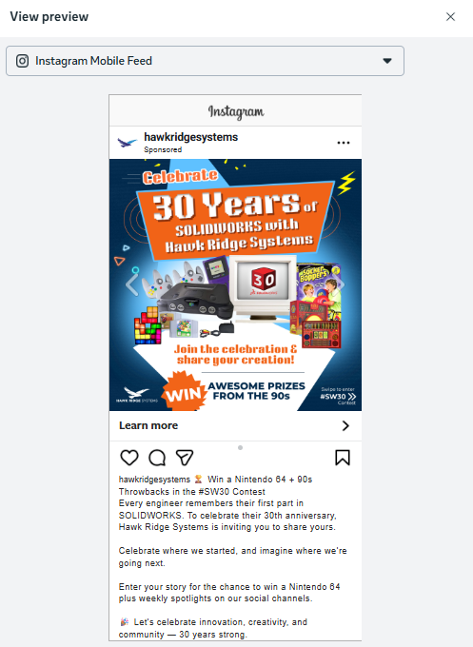
Highlights & Insights
The carousel ad generated the strongest engagement and lead quality.
Contest posts drove above-average CTRs with celebratory language.
Visuals featuring SolidWorks 30th graphics created higher recognition.
Form conversion rate indicated strong initial interest from the audience.

Slide 10
Key Takeaways
Next Steps
Celebration-based campaigns perform strongly — milestone messaging resonates with technical audiences.
Video and carousel creatives outperform static images in engagement.
Early retargeting and email follow-up could further boost conversions next time.
Most quality submissions came after our team sent emails internally to our audience.
Leverage showcase landing page
  https://hawkridgesys.com/show-case
Create a retargeting ad set using contest engagers.
Launch a follow-up campaign promoting product demos or SolidWorks learning content.

